Slide 1
Eulerian Walks
modified from: Jeff de Wet

Slide 2
Learning Objectives
To learn how to generate valid sequences from a graph using a Eulerian strategy
To become familiar with various parameters and heuristics for comparing assembly tools

Slide 3
Traversing the graph
We can use a Eulerian strategy to generate valid sequences from the graph
A Eulerian path is a traverse through the graph where each edge is visited exactly once. This lends itself well to the idea of genome assembly
To handle repeats, multiple edges can connect two nodes
gaac
aacc
acca
ccaa
caac
aact

Slide 4
Traversing the graph
We can use a Eulerian strategy to generate valid sequences from the graph
A Eulerian path is a traverse through the graph where each edge is visited exactly once. This lends itself well to the idea of genome assembly
To handle repeats, multiple edges can connect two nodes
gaac
aacc
acca
ccaa
caac
aact
gaac

Slide 5
Traversing the graph
We can use a Eulerian strategy to generate valid sequences from the graph
A Eulerian path is a traverse through the graph where each edge is visited exactly once. This lends itself well to the idea of genome assembly
To handle repeats, multiple edges can connect two nodes
gaac
aacc
acca
ccaa
caac
aact
gaacc

Slide 6
Traversing the graph
We can use a Eulerian strategy to generate valid sequences from the graph
A Eulerian path is a traverse through the graph where each edge is visited exactly once. This lends itself well to the idea of genome assembly
To handle repeats, multiple edges can connect two nodes
gaac
aacc
acca
ccaa
caac
aact
gaacca

Slide 7
Traversing the graph
We can use a Eulerian strategy to generate valid sequences from the graph
A Eulerian path is a traverse through the graph where each edge is visited exactly once. This lends itself well to the idea of genome assembly
To handle repeats, multiple edges can connect two nodes
gaac
aacc
acca
ccaa
caac
aact
gaaccaa

Slide 8
Traversing the graph
We can use a Eulerian strategy to generate valid sequences from the graph
A Eulerian path is a traverse through the graph where each edge is visited exactly once. This lends itself well to the idea of genome assembly
To handle repeats, multiple edges can connect two nodes
gaac
aacc
acca
ccaa
caac
aact
gaaccaac

Slide 9
Traversing the graph
We can use a Eulerian strategy to generate valid sequences from the graph
A Eulerian path is a traverse through the graph where each edge is visited exactly once. This lends itself well to the idea of genome assembly
To handle repeats, multiple edges can connect two nodes
gaac
aacc
acca
ccaa
caac
aact
gaaccaacc

Slide 10
Traversing the graph
We can use a Eulerian strategy to generate valid sequences from the graph
A Eulerian path is a traverse through the graph where each edge is visited exactly once. This lends itself well to the idea of genome assembly
To handle repeats, multiple edges can connect two nodes
gaac
aacc
acca
ccaa
caac
aact
gaaccaacca

Slide 11
Traversing the graph
We can use a Eulerian strategy to generate valid sequences from the graph
A Eulerian path is a traverse through the graph where each edge is visited exactly once. This lends itself well to the idea of genome assembly
To handle repeats, multiple edges can connect two nodes
gaac
aacc
acca
ccaa
caac
aact
gaaccaaccaa

Slide 12
Traversing the graph
We can use a Eulerian strategy to generate valid sequences from the graph
A Eulerian path is a traverse through the graph where each edge is visited exactly once. This lends itself well to the idea of genome assembly
To handle repeats, multiple edges can connect two nodes
gaac
aacc
acca
ccaa
caac
aact
gaaccaaccaac

Slide 13
Traversing the graph
We can use a Eulerian strategy to generate valid sequences from the graph
A Eulerian path is a traverse through the graph where each edge is visited exactly once. This lends itself well to the idea of genome assembly
To handle repeats, multiple edges can connect two nodes
gaac
aacc
acca
ccaa
caac
aact
gaaccaaccaact

Slide 14
de Bruijn Graph programs
Euler was developed for Sanger data
P.A. Pevzner et al (2001) Proc. Natl. Acad. Sci. U. S. A. 98 9748–9753.
Later extended as Euler-SR for short read data
http://euler-assembler.ucsd.edu/portal/
M.J. Chaisson, D. Brinza and P. A Pevzner (2009) De novo fragment assembly with short mate-paired reads: Does the read length matter? Genome Res. 19: 336-346
Additional features included in Velvet
Zerbino DR, Birney E. (2008) Velvet: algorithms for de novo short read assembly using de Bruijn graphs

Slide 15
There are trade-offs in parameters
Long k-mer lengths will span short repeats, but coverage goes down as k-mer length goes up – introduces sampling error
Also limited by sequencing platform read length
A single read error can affect most or all of the k-mers from a read if the k-mers are long
Higher sequence coverage corrects some for sampling error but introduces more base-call errors
Adding noise with little or no new information
Complicates graph structure and increases its size
Each error introduces bubbles or tips (spurs)
Different genomes have different structures especially as concerns types, frequencies and lengths of repeats

Slide 16
Comparison of different de Bruijn graph assembly programs (or other assemblers) is difficult because they use different combinations of heuristics
Interaction between genome composition, k-mer length, sequencing technology and heuristic approaches to graph simplification
Advice – try a couple of different programs and compare the results
Abyss and Velvet are both fast for small to medium genomes, ~50Mb or less
Large genomes mean the initial graph structures can be very large – huge memory requirements

Slide 17
Choice of type of data to gather depends on several factors
Budget, research goals
Genome type – large, small, highly repetitive …
Standard Illumina paired-end data is technically straightforward
Works using the same fragments as single end sequencing
Efficient for fragments ~400-500 bp
Can span short repeats such as Alus, but you won’t know the exact Alu sequence!
High coverage possible
Mate-pair libraries for paired sequence reads separated by greater distances are technically more difficult
Involves circularizing DNA fragments – can create chimeras that were non-adjacent fragments that got ligated together
Often get a large number of redundant paired-end reads (duplication of fragments during amplification steps)

Slide 18
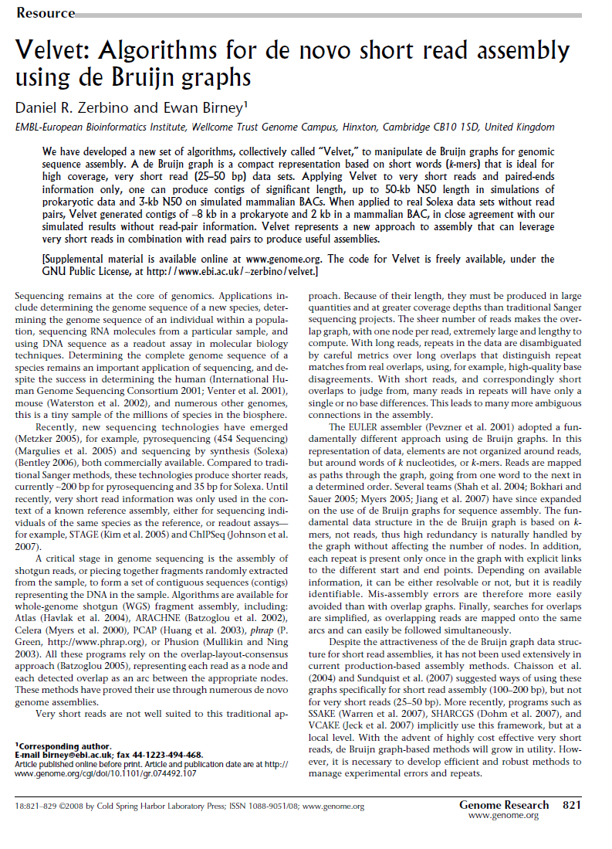
Velvet: de Bruijn graph based assembly

